Slide 2
Facelift of Majors & Degrees Website to
Support Recruitment Efforts
Presented by Admissions, Curriculum Services and
University Communications and Marketing
Notes:
Thank you for taking the time to discuss with us the state our current Majors and Degrees website and our recommendations for the future to more fully support recruitment efforts.
Lin and I am presenting on behalf of Curriculum Services, which oversees the website, and the Office of Undergraduate Admissions and the Division of University Communication and Marketing.
Administrators from these areas met several times to discuss the website and how to improve it. Folks from the Division of Information Technology were also involved in those conversations.
We know w/ budget climate the way it is that it is…an uncomfortable time to ask for funding.
Having said that, we do think this investment, which isn’t large, could positively impact enrollment and also connect to ACO messaging.

Slide 3
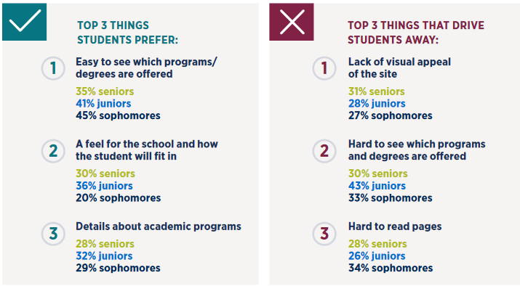
Insights from 900 High School Students
Students consider the university’s
website the most influential resource
Students not only want to find the academic programs most suited
to their interests, but they want to know what classes they’ll be taking, what jobs they will qualify for with
a certain degree, and what salaries they can expect to make
Generation Z is a generation of images, videos, memes and visual communication. The more visual your content can be, the greater levels of engagement you will achieve.
Source: 2019 E-Expectations Trend Report. Ruffalo Noel Levitz & OmniUpdate. Cedar Rapids, Iowa.
Notes:
So, why is this website an important investment?
A 2019 survey – with responses from 900 high school seniors, juniors and sophomores - found that the college website is the most influential resource for information when deciding where to go and what to study.
In addition, students overwhelming (71%) said the first action they will do after meeting with an admission counselor at high school is to go to a college’s website.
More than half of the students said they prefer websites that allow them to personalize content to meet their interests. Students not only want to find the academic programs most suited to their interests, but they want to know what classes they’ll be taking, what jobs they will qualify for, and what salaries they can expect to make.
Responses also demonstrate that the power of images and videos is undeniable—especially when illustrating campus life for prospective students.

Slide 4
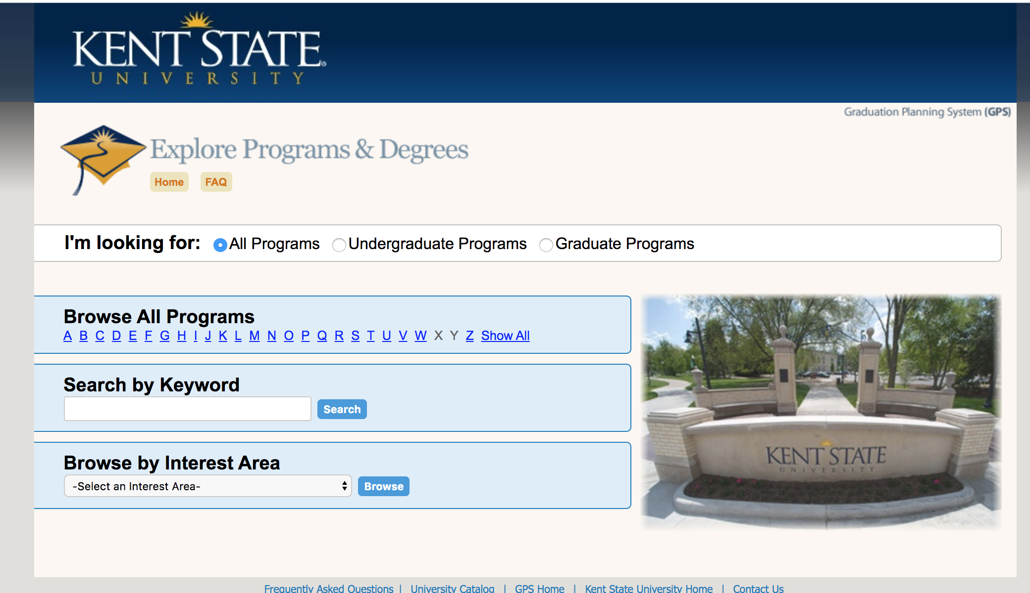
Kent State’s Majors & Degrees Current State
Notes:
So, 12 years ago, Kent State was on the forefront when we created our Search Majors and Degrees website.
LIN DANES: Current state, it's worth noting,
1. it tests well and students can find what they are looking for.
2. but it is obviously not visually appealing and that is partly because we went with a homegrown product many years ago to allow for other investments at that time and save money

Slide 5
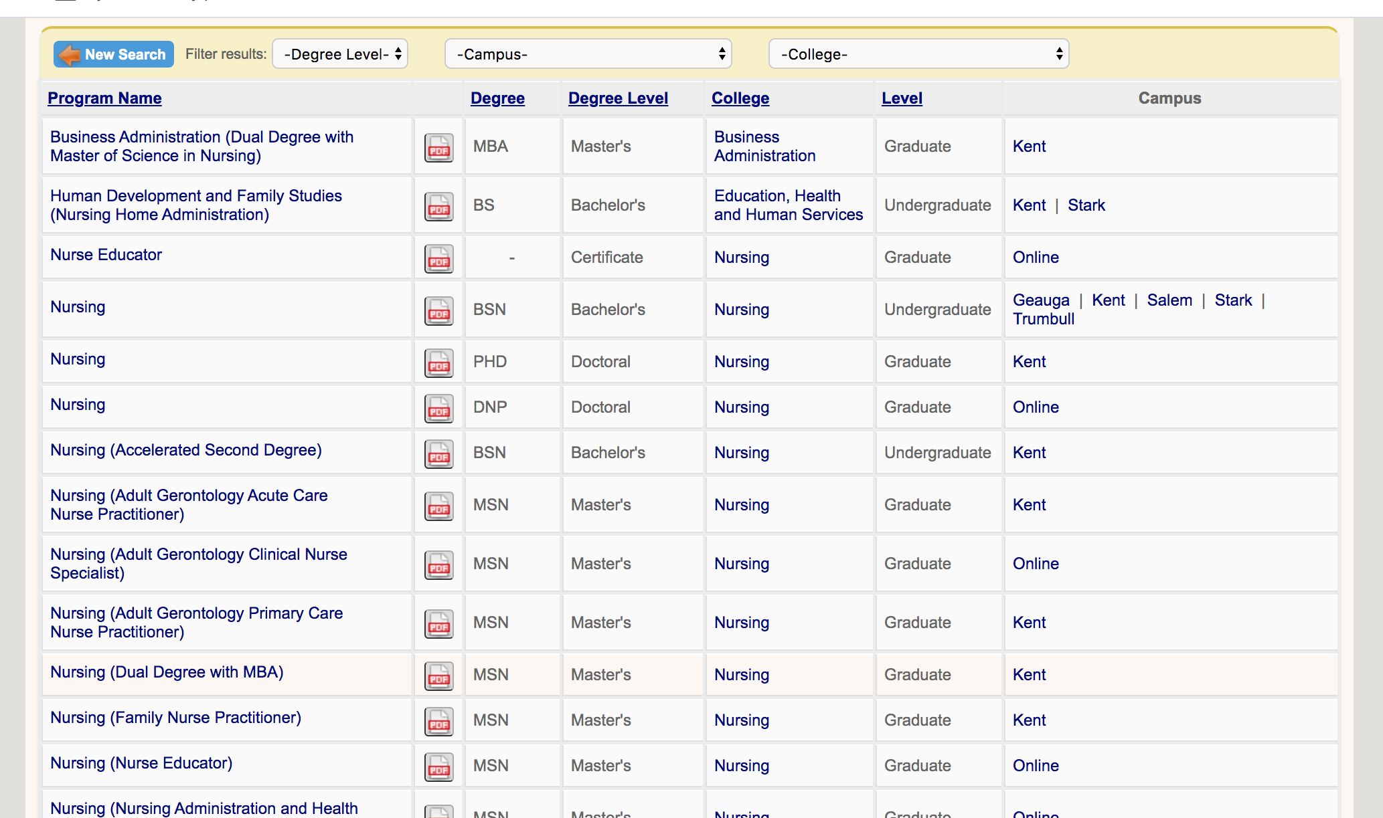
Kent State’s Current State
Benefits
Functionality has tested well
with high school students
Preferred search parameters
  Keyword, interest area, alpha list
Challenges
Aesthetically unappealing
  Very old-school look, feel
Lacks robust front-end filters
  Example: online, college
Clunky results
Homegrown and difficult to enhance, refresh
Notes:
What has served us well?
What is not serving us well now?
LIN DANES

Slide 6
Comparison of Ohio Competitors
University | Aesthetic | Filters | Labor Data
Akron | basic list | keyword | none
Bowling Green | photos, appealing | keyword, type, online, location, interest | none
Cincinnati | basic list | keyword, type, college, location, interest | none
Cleveland State | basic lists (organized by college) | none | none
Miami | basic list | alpha, type, interest | none
Ohio | basic list | type, online, college | none
Ohio State | basic, somewhat dynamic | keyword, type, college, location | none
Toledo | basic list | alpha, type, online, college, location, interest | none
Youngstown | basic lists (organized by degree, online) | none | none
Notes:
I did research on other Ohio university’s program search page.
In my opinion, we’re still ahead of all of them, Bowling Green maybe being the only exception.
I was surprised on how basic their pages are. However, that shouldn’t mean that we don’t need to improve.
LIN DANES: With new leadership coming to the university and fresh eyes and ideas, we started research into various options.
Covid delayed the proposal, as well as evaluating whether we could leverage the tools that another team was pursuing

Slide 7


Research & Discovery
Notes:
Our cross-divisional committee discussed next steps – whether we continue to utilize an in-house development or seek a vendor.
LIN DANES: First considered an in-house effort but products exist that don't impact resources and can be rolled out quickly
Two vendors we investigated were Leepfrog and Burning Glass.
Leepfrog is our current vendor for our University Catalog and our curriculum management website.
Burning Glass is a data analytics too; for career and labor information, pulling from job listings.

Slide 8
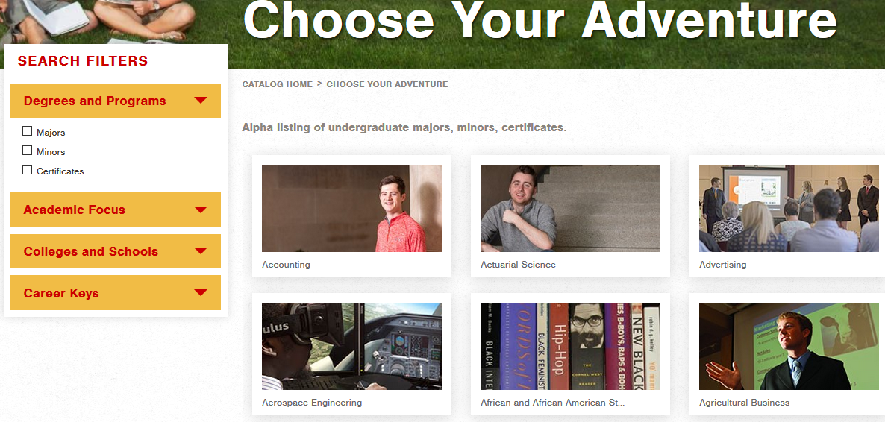
Leepfrog in Practice – Iowa State University
Notes:
https://catalog.iastate.edu/choose-your-adventure/
Pros
Trendier look and feel
Visually engaging
Robust filters
Customizable filters
Career Keys
In-page results via pop ups

Slide 9
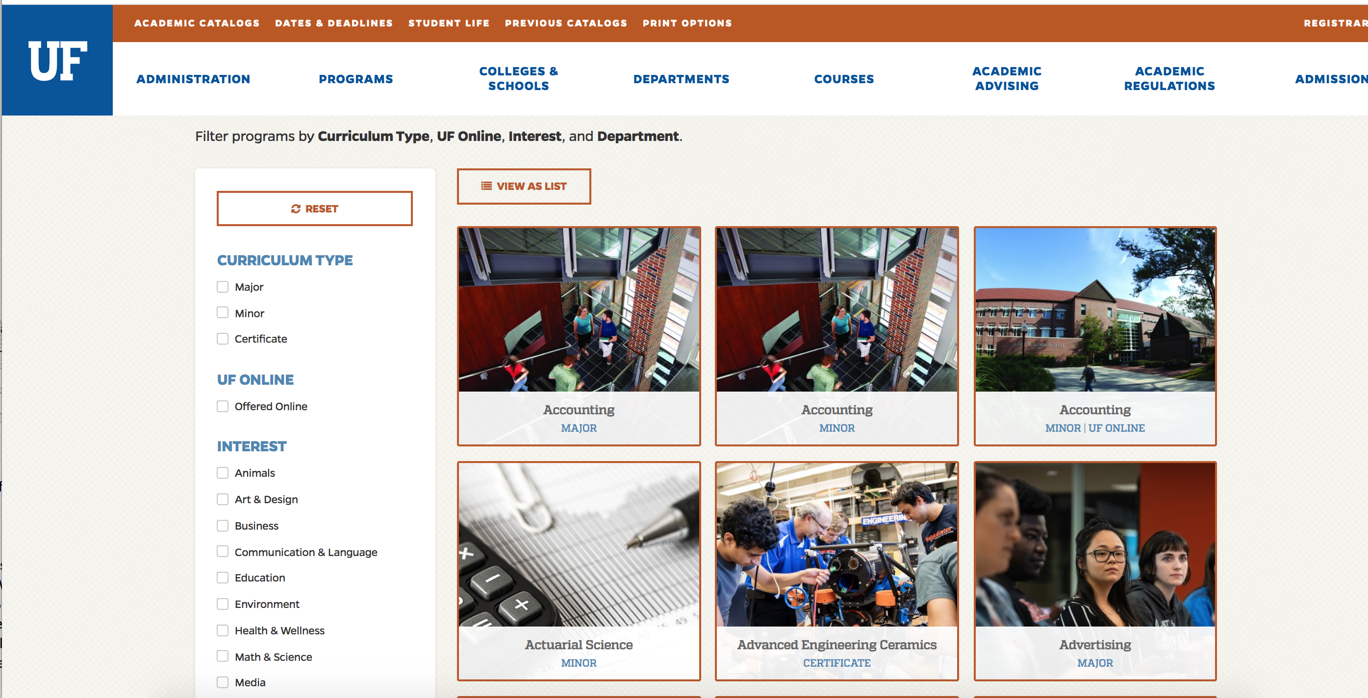
Leepfrog in Practice – University of Florida
Notes:
https://catalog.ufl.edu/UGRD/programs/

Slide 10
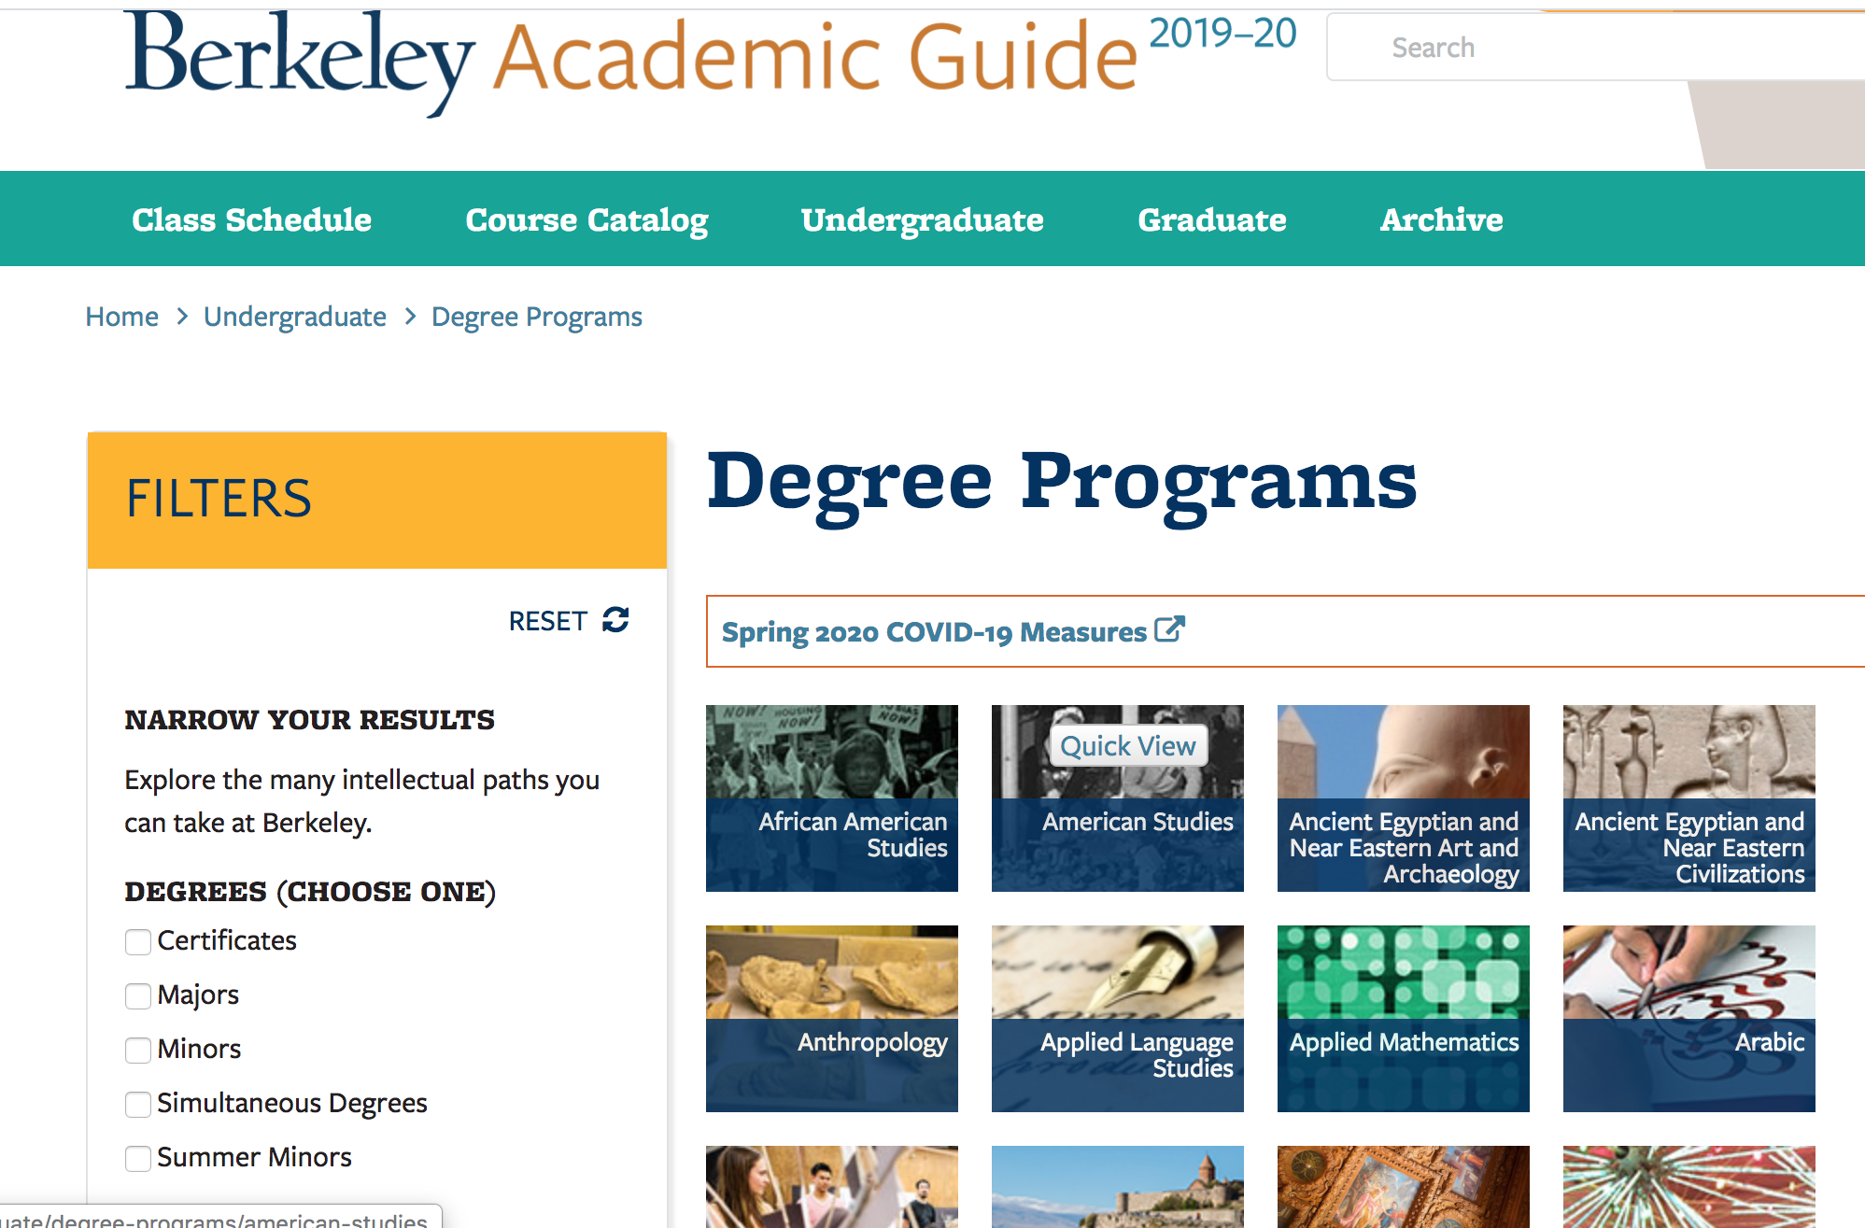
Leepfrog in Practice – University of California at Berkley
Notes:
http://guide.berkeley.edu/undergraduate/degree-programs/

Slide 11
Analysis of Leepfrog
  Benefits
    Aesthetics and visuals
    Page customization
    Automatic update of programs (i.e., no manual entering)
    Expanded, customizable search filters
    Labor information (pulled from Bureau of Labor Statistics)
    Top-notch customer service via relationship with vendor
    Low-cost, one-time purchase
  Challenges
    Will be pilot project for BLS data pull

Slide 12
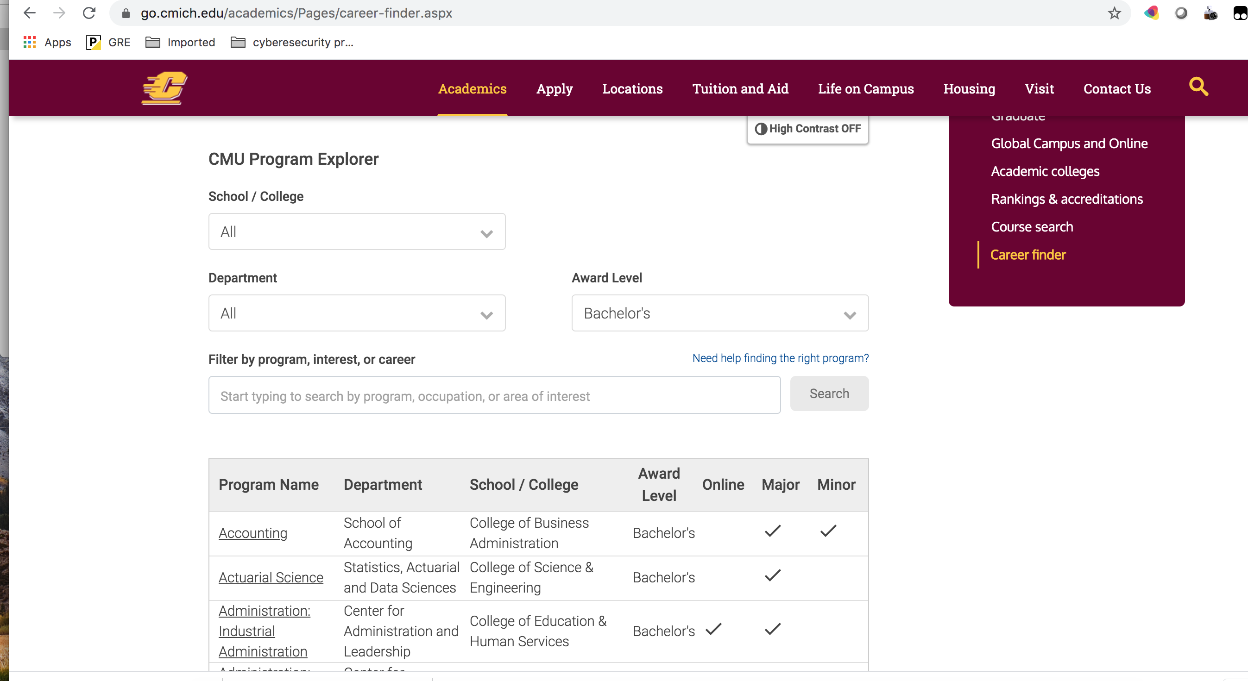
Burning Glass in Practice – Central Michigan University
Notes:
https://go.cmich.edu/academics/Pages/career-finder.aspx -- showed just one university because they would all look the same due to lack of customization of aesthetics and search filters
Career Finder > Yes > High School > Accounting > Browse All Programs
To be fair – this is really an add-on to Burning Glass’ product. What Burning Glass does well is labor and career information for program development and student career exploration. They are not in the business to provide a program search functionality for a university.

Slide 13
Analysis of Burning Glass
Benefits
  Impressive career information aligned with programs
  Could be useful to Career Services or those determining curricular decisions
  Data analytics on user searches
Challenges
  Off-the-shelf product – little customization
  Does not support multiple campuses
  Aesthetically unappealing
  Manual update of program information
  Complicated user interface
  Cost – annual lease
    Note: Uses job postings vs. Bureau of Labor statistics

Slide 14
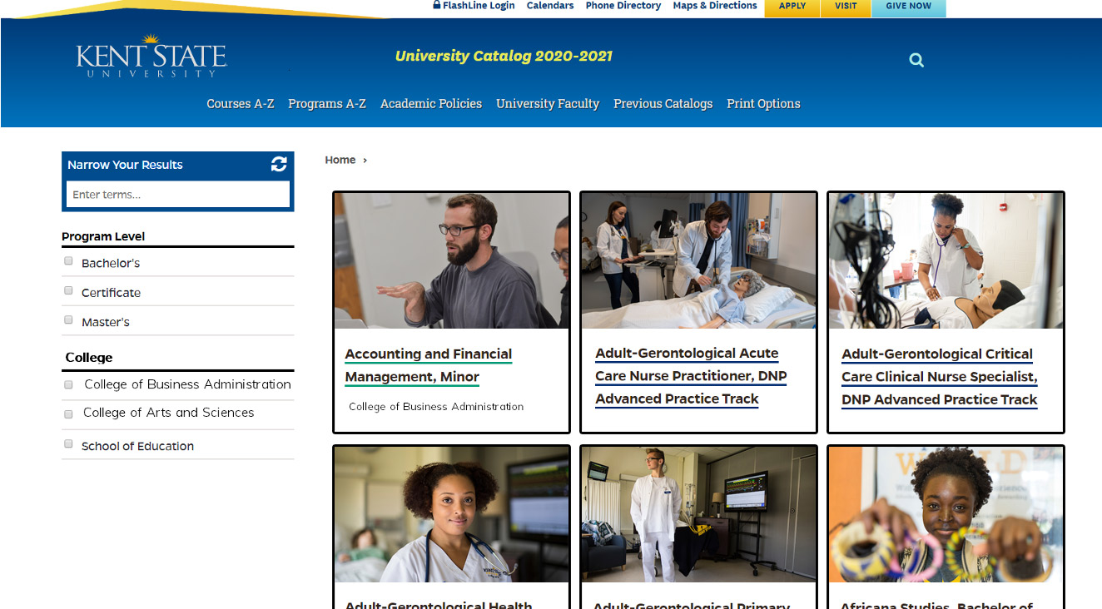
Recommendation: Leepfrog
Benefits
Face lift with imagery
Retention of preferred search functionality by keyword, interest area, full alpha list
Addition of more robust filters (online, college, campus)
Easier enhancements and refreshes
Notes:
Refresh the top menu to downplay the catalog – very much like what the University of Florida has done Refresh landing page to include more labor/career information, pictures and videos.

Slide 15
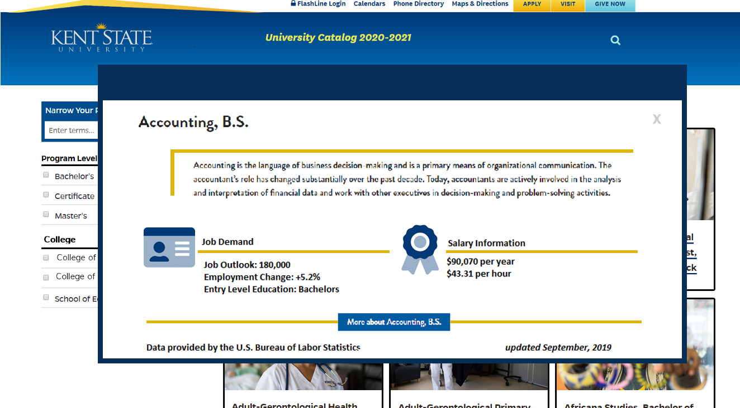
Recommendation: LeepFrog
Benefits
Addition of job outlook information, which we currently are lacking
Connectivity to Bureau of Labor Statistics
Flexibility to add more language directed toward prospective students
Notes:
LIN DANES: Job outlook information is a nice tie in to the ACO messaging particularly around outcomes and would give us an edge over competitors
If we could pursue this, down the road it could be valuable to also consider on additional Leepfrog component. I know this would provide value for the current cybersecurity effort

Slide 16
LeepFrog Investment Cost & Implementation
Cost
  $15,000
  One-time cost
  No annual fee
Implementation, estimated
  Four weeks for vendor
  Projections for Kent State team to be determined
    Largest time investment: finding and uploading photos to support programs
    Formalized timeline would be developed if funding is approved
  Theoretically, depending on contract start date could strive for August or September implementation
Notes:
Maintenance is bundled into the annual fee we already pay for the University Catalog.

Slide 17
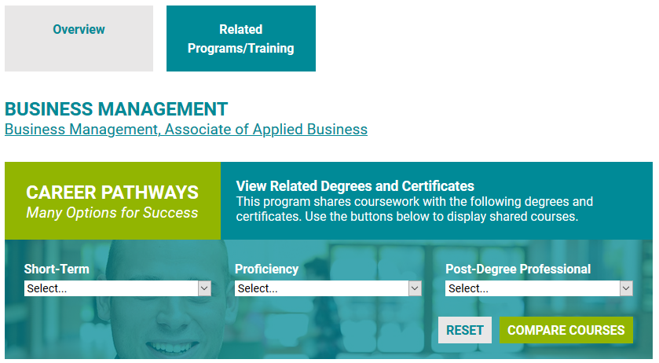
Recommendation: Leepfrog Phase 2
New Feature:
Academic
Pathways*
Example: Cuyahoga
Community College
  *Will be an additional
  one-time cost
Notes:
We recently learned about this new feature and we’re doing more research.
Cybersecurity

Slide 18
Thank You.
www.kent.edu
Notes:
What do think? Do you want to pursue this?

