Slide 1
Preview of the
Search Majors Website and
2021 University Catalog
Office of Curriculum Services

Slide 2

Academic Affairs
Aimee Bell, Academic Program Coord, Curriculum Services
Jennifer Kellogg, Asst Director, Curriculum Services
Jody Patterson, Assoc Director, Career Exploration & Development
Therese Tillett, Assoc VP, Curriculum Planning & Administration
Kristin Williams, Exec Director, Career Exploration & Development
Enrollment Management
Sean Broghammer, Assoc VP, Admissions
Vince Slomsky, Director, Strategic Communication
Joanna Liedel, Director, Academic Partnerships
Lana Whitehead, Director, Strategic Initiatives
Information Technology
Altai Otgonyin, Team Leader, Systems Development
University Communications and Marketing
Lin Danes, Director, Web Services & Interactive Media
Timothy Priester, Lead Web Designer & Services
Todd Snider, Asst VP, Marketing Strategy
A Collaboration With
Started in Fall 2019

Slide 3

Search Majors Website Enhancements

Slide 4
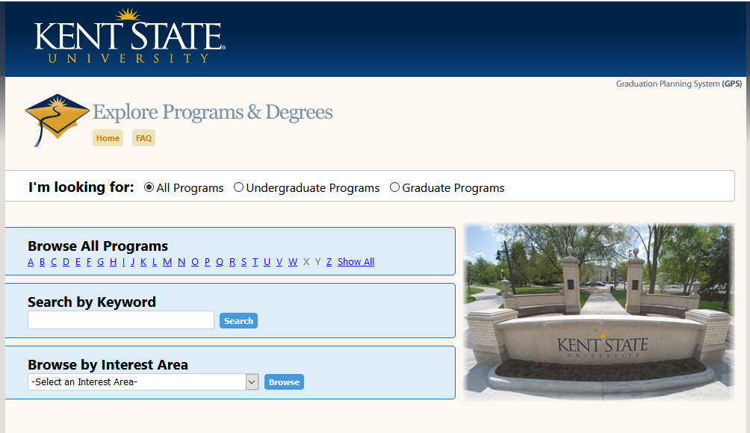
Current Search Majors Website

Slide 5
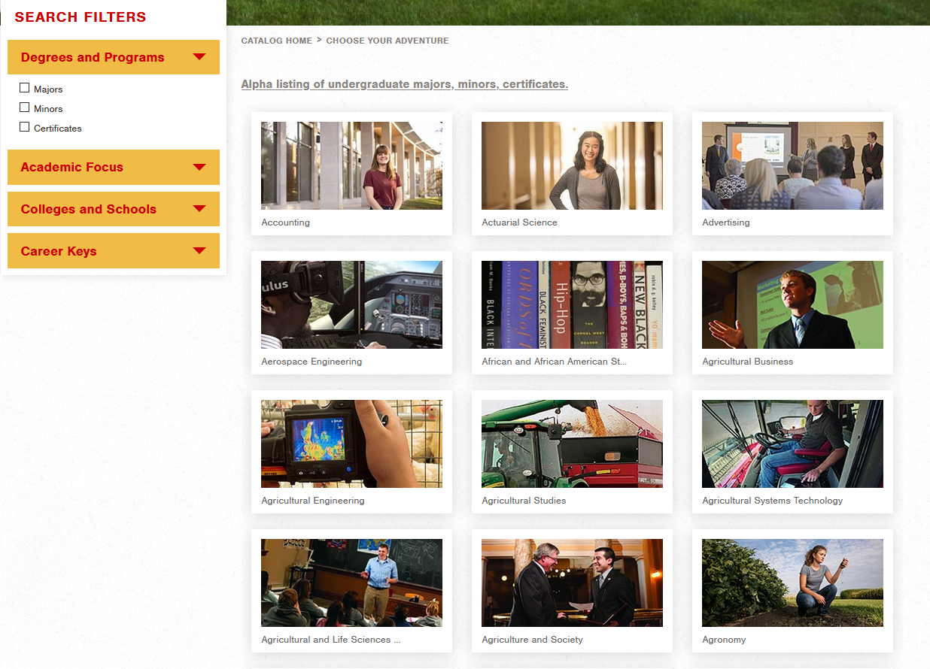
Functionality of the New Search Website

Slide 6
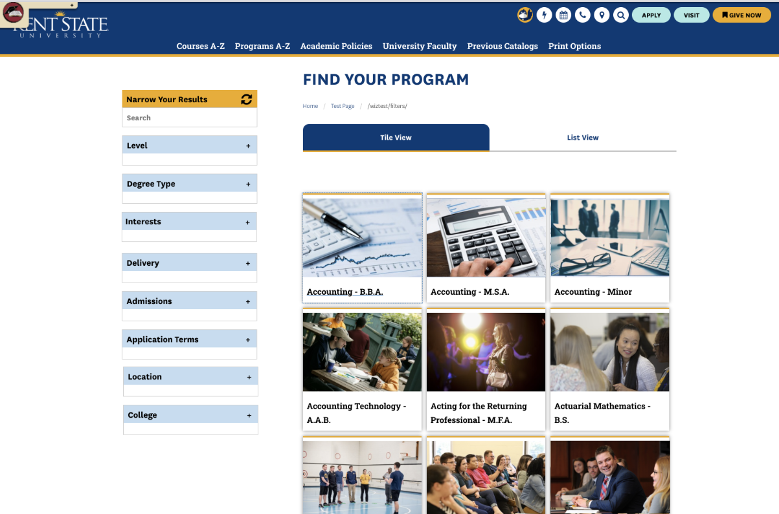
Design of the New Search Website

Slide 7
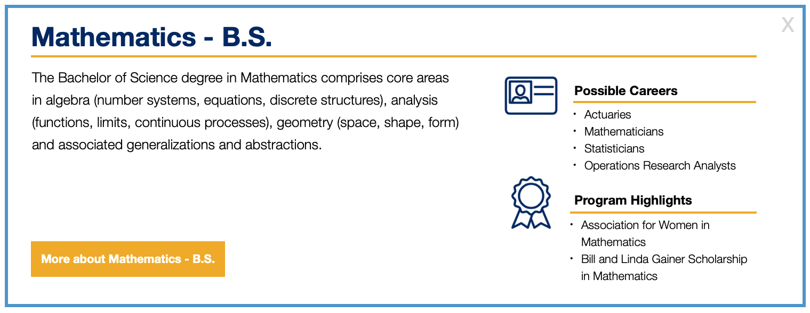

Design of the Pop-Up

Slide 8
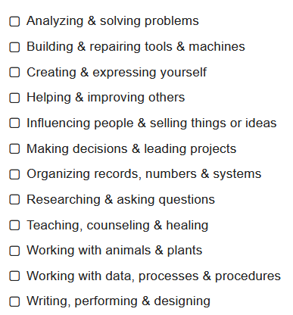
New Interest Areas
Based on the Holland Code
  Realistic
  Investigative
  Artistic
  Social
  Enterprising
  Conventional
Matches interests to occupations
Crosswalk: program CIP to SOC to
Holland Code
Tweaked when needed

Slide 9
Catalog Enhancements

Slide 10
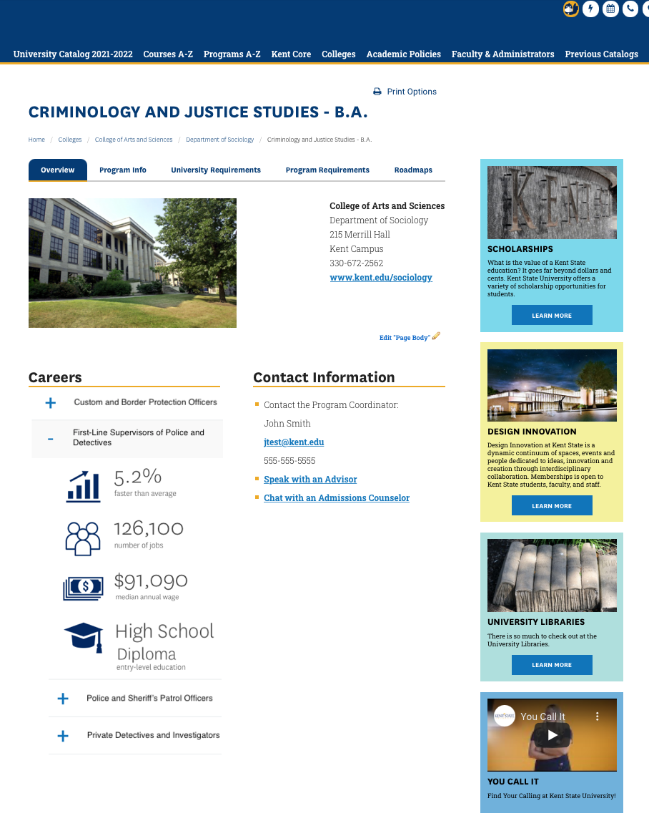
New Catalog Overview Tab
Photos and videos
Labor data
More contact information

Slide 11
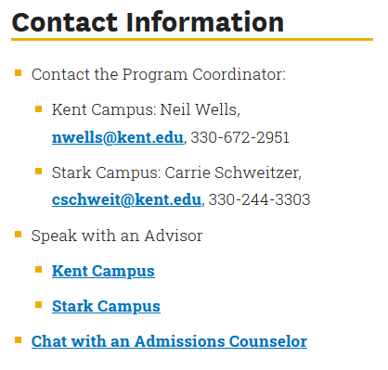
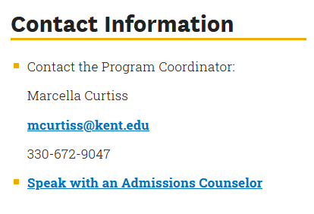
Contact Information
Undergraduate Program
Graduate Program

Slide 12
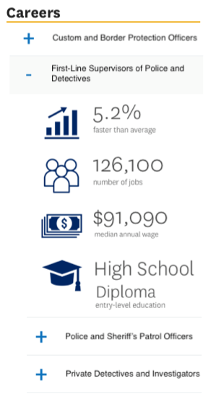
Labor Data for Occupations
Pulled from U.S. Bureau of Labor Statistics
Automatically refreshed each year
Accordion to display data for multiple occupations
Ability to select occupations
No display if desired

Slide 13
Promos!!

Slide 14
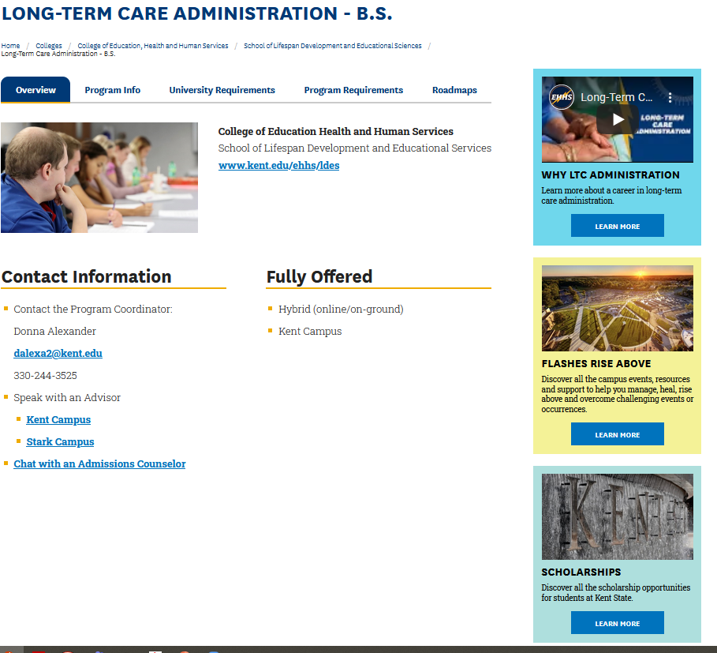
Promos
Promos run alongside each
catalog page
May be tailored for a specific
program, department, college, division or be university wide
Can be a video or picture
Link to a Kent State website
for more information

Slide 15
Thank You.
Questions?

